Slide 1
jQuery
25 Apr 18 | Start
Appendix
Online

Slide 2
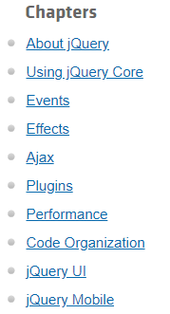
jQuery
Ch | Date
1 | 00 May 18
2
3
4
5
6
7
8
http://learn.jquery.com/

Slide 3
1
About jQuery

Slide 4
Intro
Getting started with jQuery can be easy or challenging, depending on your experience with JavaScript, HTML, CSS, and programming concepts in general.
In addition to these articles, you can read about the history of jQuery and the licensing terms that apply to jQuery projects.
You can also make a donation to help the jQuery team continue to improve jQuery.
One important thing to know is that jQuery is just a JavaScript library.
All the power of jQuery is accessed via JavaScript, so having a strong grasp of JavaScript is essential for understanding, structuring, and debugging your code.
While working with jQuery regularly can, over time, improve your proficiency with JavaScript, it can be hard to get started writing jQuery without a working knowledge of JavaScript's built-in constructs and syntax.
Therefore, if you're new to JavaScript, we recommend checking out the JavaScript basics tutorial on the Mozilla Developer Network (MDN).

Slide 5
How jQuery Works

Slide 6
2
Using jQuery Core

Slide 7
3
Events

Slide 8
4
Effects

Slide 9
5
Ajax

Slide 10
6
Plugins

Slide 11
7
Performance

Slide 12
8
Code Organization

Slide 13
9
jQuery UI

Slide 14
10
jQuery Mobile

